Slide 1
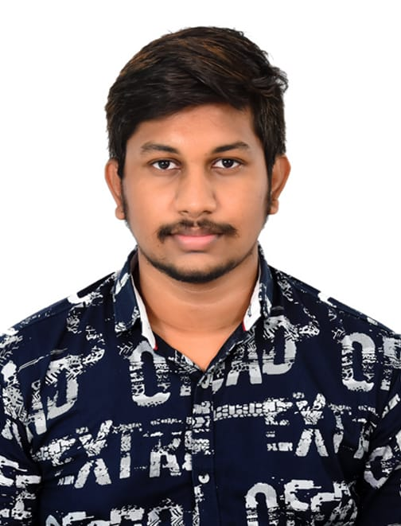

Irrinki Hari Krishna
Analyst/Software Engineer
Bachelor of Engineering
electrical and electronics : 2018- 2022
Skills
Bangalore
Irrinki-hari.krishna@capgemini.com
Java 8 /J2EE | Java Basics, OOPS, Generics, Collections, Arrays, Loops, Lambda Exp, Stream API Junit, Mockito, Servlets
Spring core | IOC & Dependency Injection, Autowired
Spring REST | REST controllers, Implementation of GET, POST, PUT & DELETE, Bean Validation & Exception Handling, Testing Services, Controller & Repository layer
Spring Boot Microservices | Spring Boot Starters, annotations, Swagger API documents
Spring Cloud | Eureka,Netflix Hystrix, Netflix Zuul & Config Server
React | Components, Hooks, Event handling, Redux, Reducers
Angular | Components, Services, Modules, Routing, Forms & Validation.
Database | MongoDB
UI Tech | HTML 5 & CSS 3,JavaScript, ES6 & TypeScript Reusable templates, Optimized UI Designed
Tools | Git, Postman
Add On skills | Communications, Team management. Peer learning
+91 8309375376
A4
Full Stack Developer
Hands on experience in creating microservices with Springboot, Spring Security, Spring Cloud API Gateway, Eureka server.
Proficient in creating Single page Web Application in Angular with Authentication with route guards, Angular reactive forms, angular routing, CSS
Hands on experience in implementing polyglot architecture with NodeJs & spring boot
Experience in creating documentation with Java docs and swagger and in unit testing using Junit, Mockito i
On Demand Car Wash Application
Completed end to end case study of on demand car wash Application along with Swagger and responsive UI with CSS and Angular used for user interface.
Successful Completion of "Step into Robotic Process Automation"during GUVI's RPA SKILL-A-THON 2020
Certified from APSSDC on completing "Basic Python Programming" (06/2020 - 07/2020)
Certified from VEDIC on completing ""Web Development Programming " (06/2021)
AWS Cloud Practitioner Certified

